Slide 1


Tailai Chang
Lucas Yang
Young Kim
Measuring the Power of Organizational Network
One International
Notes:
Photo by Jorge Vasconez on Unsplash

Slide 2

Why Organizational Network Analysis matter?
Types Downward
Upward
Horizontal
Diagonal
01
Information & Communication Flow ONA analyzes and visualizes patterns of collaboration by examining the frequency, strength, and nature of interactions within networks.
Issues Organizational silos
Information bottleneck
Lack of consensus
Negative culture
02
Organizational Issues
It can help diagnose various organizational issues and devise appropriate interventions.
Influencer & Outsider
It can help identify key influencers to enhance business performance through increased connectivity. Additionally, we can find outsiders who rarely communicate with other colleagues.
Change management
Leaders can leverage the existing, but hidden networks to drive change within a firm.
ONA
03
People Metrics Final Presentation

Slide 3
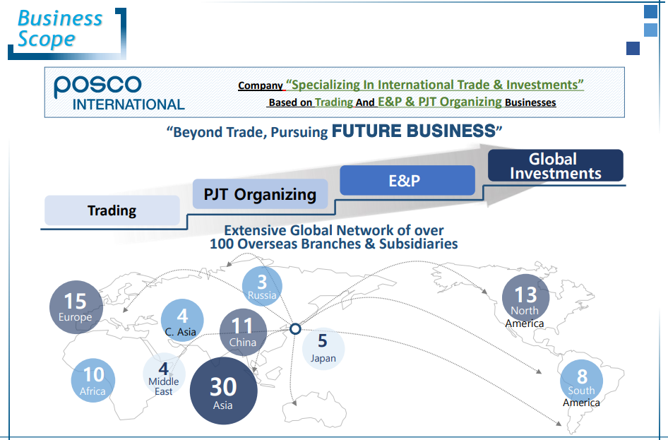


Company Introduction
One International
Misaeng: Incomplete Life (TV series on Netflix)
People Metrics Final Presentation

Slide 4
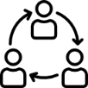

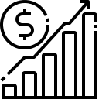
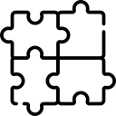

One International
Attain Benefits of Synergy Through Effective Global Collaboration
Faster movement through information sharing
and new business opportunities by synthesizing diverse ideas.
Enhance M&A Integration Process
Increase the Company’s Revenue
The company needs to overcome
resistance to change, peed up
integration, and ensure more cohesive
cultural merger by reflecting local opinion leaders’ suggestion.
For this, the company can improve internal collaboration and identify “hidden stars” that drive sales success.
Organizational Restructuring
Innovation
The main drivers for consolidation were to establish a set of consistent processes so that internal and external customers receive a consistently higher level of service.
The company needs to streamline decision-making processes and enhance product development cycle times.
5 Needs
People Metrics Final Presentation

Slide 5
General Model for ONA
ORGANIZATIONAL CONNECTIVITY
Intricate web of interactions and communication
Static & Dynamic connections: Information flow, robust collaboration , resilient structure
CONSTRUCT
4 DIMENSIONS
Communication Dynamics
Network Structure
Collaborative Capacity
Cultural Cohesion
DIMENSIONS
NUMEROUS ELEMENTS
16 elements in total
Building blocks for ONA measurements
ELEMENTS
CHALLENGE
People Metrics Final Presentation

Slide 6
Model Structure
[C] Organizational Connectivity
[D] Communication
Dynamics
[D] Network
Structure
[D] Collaborative
Capacity
[D] Cultural
Cohesion
[E] How frequently do team members engage in cross-departmental communication?
[E] Are there established protocols for bottom-up communication allowing for feedback and ideas to reach upper management?
[E] What proportion of communication utilize digital platforms versus face-to-face interactions?
[E] Which individuals or teams are identified as central nodes within the organizational network based on the volume of interactions?
[E] Is there evidence of isolated clusters or teams within the organization that rarely interact with others?
[E] How many cross-functional teams exist, and what is the frequency of their meetings and interactions?
[E] What percentage of projects are completed with contributions from multiple departments?
[E] How are collaborative efforts documented and shared across the organization?
[E] Are there recognized barriers to collaboration, and how often do they occur?
[E] Do employees have a clear understanding of the organization's core values and mission statement?
[E] How often do employees participate in activities that reinforce the organization's culture?
[E] Is there a measure of how aligned individual goals are with the overall organizational goals?
People Metrics

Slide 7



Current Measurement Tools
01
Employee Collaboration
Survey
We can get valuable insights for individual and team performance as well as perceptions of collaboration through traditional ways.
Ease of communication
Frequency of cross-functional interactions
Satisfaction with collaboration tools
Ex) Periodical survey for communication effectiveness
* Issues: Subjective Perceptions (Personal biases)
02
03
360-Degree Feedback
Performance Assessments
A comprehensive view of an employee’s performance and their interaction with different levels within the organization.
Ex) 360-degree feedback process as part of performance review cycle
Metrics related to teamwork and
Collaboration
Ex) Performance appraisals to evaluate employees’ collaborative efforts, especially on cross-functional projects
People Metrics Final Presentation

Slide 8
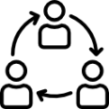




Improved Measurement Tools
* More Objective and Scientific Tools
Collaboration
Intensity Score
Central Node
Influence Score
Meeting Frequency Score
Collaboration
Time Score
Juridical Network
Understanding
Assesses how often and how effectively team members engage with each other to achieve mutual goals
Ex) Engagement in cross-functional PJT
Evaluates the role and impact of central figures who facilitate information flow and decision-making
Ex) Person who is frequently consulted by many
Measures the number and effectiveness of interdepartmental meetings
Ex) Departments that have regular, outcome-oriented meetings
Quantifies the amount of time spent on collaborative activities and how this time correlates with productivity
Ex) Using collaboration time efficiently
Reflects the depth of understanding of the organizational network and its influence on decision-making
Ex) Decision that align with the network analysis
1
2
3
4
5
People Metrics Final Presentation

Slide 9
ONA Data Sources
Active Sources
Passive Sources
Require direct input, like ONA surveys, offering deep insights into expertise, leadership, and culture..
Automatically collected, such as Slack, Microsoft Teams, Google & Outlook Calendars, Email, and CRM systems like Hubspot and Salesforce, providing real-time collaboration insights..
Key Insights
Advantages
Combining active and passive sources yields the most comprehensive organizational map, capturing the structure, interaction patterns, and informal exchanges.
Active sources detail relationship types and influence, while passive sources highlight collaboration dynamics and communication patterns.
Integration Benefit
Conclusion
Integrating active and passive data sources in Organizational Network Analytics enriches organizational mapping by combining direct employee input with real-time collaboration insights.
The synergy between active and passive data enhances the understanding of organizational networks, crucial for focusing on increasing passive data leads due to their growing prevalence and depth of insight.

Slide 10
Active vs. Passive Data Sources in ONA
01
02
Active Data Sources
Passive Data Sources
Brief Description
Brief Description
Require direct employee input through surveys.
Automatically gather insights from collaboration tools.
A
B
Example
Example
active sources require employees to complete surveys, while passive sources extract insights from the organization's collaboration techniques.
Slack, Teams, Google Calendar, Email, and CRM systems. As diverse collaboration technologies become more prevalent, the amount of passive data is increasing significantly, making it critical for companies to focus on these leads.
People Metrics Final Presentation

Slide 11

Derive Numerical Scores
No | Aspect | Data Source | Scoring Criteria (Points)
1 | Communication | Slack, Teams, Email | High: 5, Medium: 3, Low: 1
2 | Influence | ONA Survey | High: 5, Medium: 3, Low: 1
3 | Meeting Frequency | Calendar | Regular: 5, Occasional: 3, Rare: 1
4 | Collaboration Time | CRM Systems | Adequate: 5, Moderate: 3, Insufficient: 1
5 | Leadership | ONA Survey | Strong: 5, Moderate: 3, Weak: 1
6 | Organizational Culture | Enterprise Social Media | Strong: 5, Moderate: 3, Weak: 1
The scoring approach details six key dimensions of organizational network analysis, each with corresponding data sources such as Slack and email for assessing communication frequency and corporate social media for assessing organizational culture, and provides a specific scale from 1 to 5 for each dimension based on high, medium, and low performance.
People Metrics Final Presentation
11

Slide 12
Measuring Organizational Connectivity
This comprehensive model converts the abstract construct of Organizational Connectivity into a quantifiable score, reflecting the health of an organization's communication, structure, collaboration, and culture.
Data Collection
Data Processing
Score Calculation
Validation
Gather data from ONA surveys, communication platforms, calendars, CRM systems, and social media platforms.
Preprocess and clean data, extract relevant interaction and collaboration features, and apply normalization and weighting.
Assign scores for communication dynamics, network structure, collaboration capabilities, and cultural cohesion.
Benchmark scores against organizational metrics, calibrate based on feedback to refine the measure.
01
02
03
04
People Metrics Final Presentation

Slide 13

Identifying Threats
01
To understand and optimize organizational networks, potential threats to the validity and reliability of the measurement process must be acknowledged and addressed. Just as a map is only helpful if it accurately represents .
Random Errors
Sampling Bias
Response Variability
Data Collection Methods
Technical Failures
03
02
Conclusion
Systematic Errors
Proactive measures such as diverse sampling, bias reduction, and rigorous data validation are vital to maintaining the integrity of ONA measurements
Social Desirability Bias:
Platform Usage Bias
Cultural Influences
Data Integration
People Metrics Final Presentation

Slide 14



Implementation
Practice
Potiential risk
mitigation plan
People Metrics Final Presentation
Notes:
Photo by John Schnobrich on Unsplash

Slide 15
Practice
Compensation
The measure should be used in practice to enhance organizational effectiveness, collaboration, and innovation.
Bringing it into compensation and performance evaluations can obtain better understanding into Human resource management.
Compensation models could be adjusted to reward those who contribute significantly to the organizational network's health and efficiency, acknowledging their role in enhancing collective performance.
evaluations
ONA might uncover employees who are central to information flow or problem-solving but are otherwise under the radar in traditional performance evaluations. This can lead to more equitable recognition and reward systems.
Access
It should be accessible to organizational leaders and managers to inform strategic decisions and interventions.
01
02
03
People Metrics Final Presentation

Slide 16

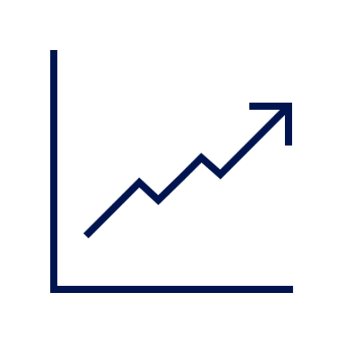
Implementation
“gaming the system”
01
03
overly focusing
Knowing that metrics such as the number of connections or frequency of interactions are being monitored, employees might engage in superficial or non-productive communications simply to inflate their ONA metrics.
Potiential risk
An overemphasis on network metrics can undervalue the contributions of introverted employees or those who prefer to work independently.
02
04
employees’ privacy
Ownership of data
The collection and analysis of data on who communicates with whom, how often, and in some cases, the content of these communications, can feel like surveillance to employees.
Employees may be concerned about the potential for data to be used for purposes beyond the original intent, such as for making decisions about layoffs, promotions, or other HR-related actions.
People Metrics Final Presentation
Notes:
Photo by Brooke Cagle on Unsplash

Slide 17

mitigation plan
1
2
Find balance
Regularly adjust
Use ONA as one of multiple metrics to assess employee contributions, ensuring that both collaborative and individual achievements are recognized.
Regularly review and adjust ONA metrics and their application to ensure they are promoting the desired behaviors without unintended negative consequences.
Transparent
Consent
Organizations should be transparent about the use of ONA, including what data is collected, how it is analyzed, and how insights derived from it will be used.
Implementing strict data protection measures, including anonymization of data where possible and ensuring that data is only accessible to authorized personnel, is crucial.
4
3
People Metrics Final Presentation

Slide 18


Thank You.
People Metrics
Final Presentation
Notes:
https://unsplash.com/

